Slide 1
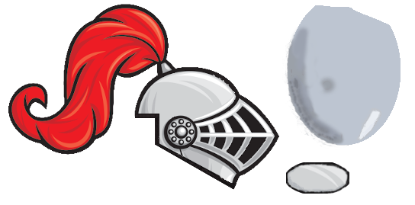
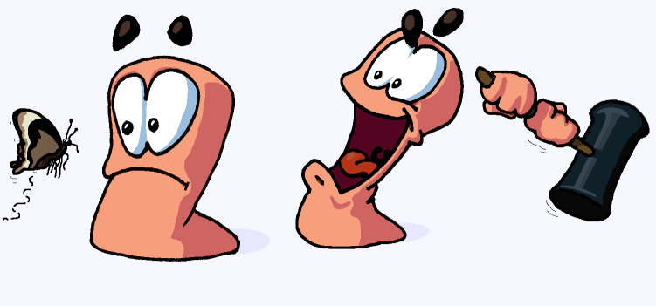
Team 4
Squires: Knights in the Making
By:
Alex Ogilbee
Joseph Hill
Fernando Trevino

Slide 2
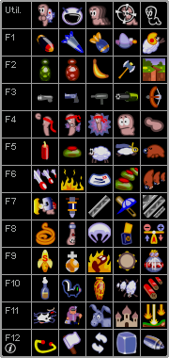
Game Explanation
2D turn-based tactical shooter, inspired by Worms
Environment
Tile-based destroyable map
Environment adversaries such as the sun attacking you
Weapons and Tools
Arsenal of weapons shared by each team
Weapon Types: Gun, Launcher, Melee, Grenades
Tools: Teleporter, Tile Creator/Remover
Player Controls
WASD or Arrows for movement
Mouse for aiming

Slide 3
Playtesting ?
Question | Avg Score
Intuitive Controls | 4.7
AI was Fun | 3.2
Environment Hazards improved gameplay | 3.5
Weapons were fun | 5
Enough Weapon variety | 4.8
Seamless Camera Transitions | 4.3
Enough time per turn to make decisions | 4.5
The music and SFX fit the game | 4.2
The Menu is easy to Navigate | 4.5

Slide 4
Iteration: Favorite Weapon

Slide 5
Data Driven All

Slide 6
Software Design All
Game Manager including a lot of stuff
Should’ve made more things singleton at first
Made some things more specific, could’ve refactored code early to be reusable
Weapon Design
Easily adjust to playtesting
Generalized a lot of scripts, like Grenade script that was reused for…

Slide 7
Player AI Design F

Slide 8
Game Balance A
Weapon ammo amounts
Weapon global effects
Damage, different for environment and players
Health

Slide 9
User Interface A
Make game options informative but not overwhelming
Original game menu versus simplified screenshots

Slide 10
Level Design J

Slide 11
Environment AI Design J

Slide 12
Issues with AI Development JF
Calculating jumping with dynamic map
Having the AI use specific weapons

